Slide 1
Problem Statement
Running GenAI on Intel AI laptops and Simple LLM Inference on CPU and fine-tuning of LLM Models using Intel OpenVINO

Slide 2
Unique Idea Brief(solution)
A Question and Answer (Q&A) chatbot is a type of artificial intelligence (AI) system designed to automatically respond to user inquiries.
A Q&A chatbot enhances user experience by providing instant, accurate responses, reducing the workload on human agents, and improving efficiency in various domains.

Slide 3
Features
Key features of a question and answer chatbot include:
Natural Language Understanding (NLU): Ability to comprehend the meaning behind user queries, considering context and intent.
Knowledge Base: A repository of information from which the chatbot retrieves answers. This could be a structured database, documents, or a collection of pre-defined responses.
Conversational Flow: Capable of maintaining a coherent conversation by following up on previous exchanges and responding appropriately.
Accuracy and Relevance: Provides accurate and relevant answers based on the user's query, leveraging algorithms to prioritize the most fitting responses.
Scalability: Can handle a large volume of queries simultaneously and adapt to varying levels of complexity in questions.
Feedback Mechanism: Often includes a mechanism to learn from user interactions, improving its responses over time through machine learning or rule-based adjustments.
Integration: Can be integrated into various platforms such as websites, messaging apps, or voice assistants, enhancing user accessibility. Applications of question and answer chatbots span customer service, e-commerce, education, healthcare, and more, offering efficient and immediate access to information without human intervention.

Slide 4
Process flow
The process flow of a question and answer chatbot typically involves several stages, from receiving the user's query to providing a response. It involves:
1. User Interaction
User Input: "What's the weather like in New York today?"
2. Pre-processing
Text Normalization: "what's the weather like in new york today"
Tokenization:["what's", "the", "weather", "like", "in", "new york", "today"]
3. Intent Recognition
Intent Detection: The intent is identified as "get_weather".
Entity Recognition: The entities identified are "New York" (location) and "today" (date).

Slide 5
4. Context Management
Context Tracking: The chatbot notes that the user is asking about the weather and that the location is New York and the time frame is today.
5. Query Handling
Knowledge Base Query: The chatbot does not have the weather data, so it needs to call an external weather API.
External API Call: The chatbot calls a weather API with the parameters "New York" and "today".
6. Response Generation
Answer Generation: The API returns the weather information: "The weather in New York today is sunny with a high of 75°F and a low of 60°F."
Natural Language Generation (NLG): The response is formulated: "The weather in New York today is sunny with a high of 75°F and a low of 60°F."

Slide 6
7. Post-processing
Response Formatting: Ensure the response is clear and formatted correctly.
Personalization: If the user has interacted with the chatbot before, it might add, "Hope you enjoy your day in New York!"
8. User Feedback
Response Delivery: The chatbot sends the response back to the user.
Feedback Collection: "Was this information helpful?"
9. Learning and Improvement
Logging and Analytics: The interaction is logged for future analysis.
Model Training: If the feedback is collected, it is used to improve the model's performance.

Slide 7
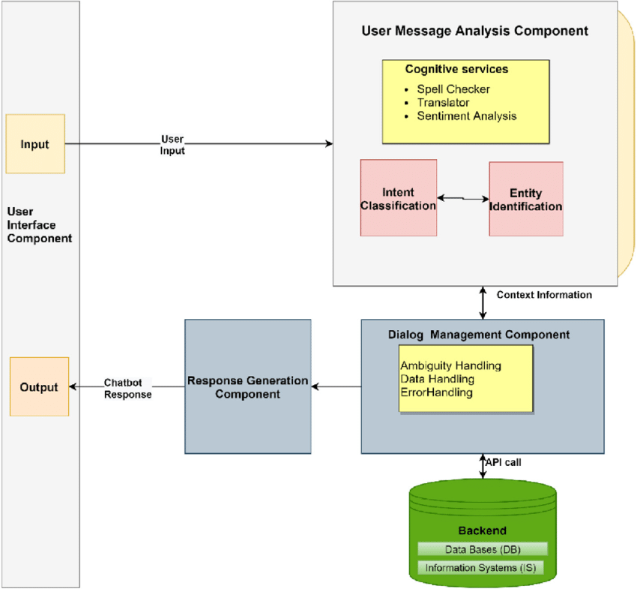
Architecture Diagram

Slide 8
Use case
Customer Support : Automated assistance for answering frequently asked questions, handling basic customer service tasks, and escalating issues to human agents when necessary.
Educational Tools: Assisting students with homework, providing explanations of concepts, and offering additional learning resources.
Internal Helpdesks: Assisting employees with HR-related questions, IT support, and company policies.
E-commerce: Helping customers find products, answering questions about orders, and providing information on returns and shipping.

Slide 9
Technologies used
Streamlit is an open-source app framework for Machine Learning and Data Science projects. Streamlit makes it easy to build custom web apps for machine learning and data science projects with simple Python scripts. When combined with requests for making HTTP requests and streamlit-chat for creating a chatbot interface, you can quickly build and deploy a question and answer chatbot.
Streamlit: For building the web application interface.
Streamlit-chat: For creating a chatbot interface within Streamlit.
Requests: For making HTTP requests to external APIs (e.g., NLP API, weather API).

Slide 10
Team members contribution
Team member 1-BHAGHYASHREE S PATIL
Project Management / Team Leader:
Overall Coordination: Oversees the project from inception to completion.
Resource Allocation: Ensures the team has the necessary resources and support.
Software Development:
Programming: Write code for the bot's functionality.
Integration: Integrate the bot with various platforms or APIs.
Testing and Debugging: Ensure the bot functions correctly and fix any issues.

Slide 11
Team member 2-Arpita A M
Content Creators / Subject Matter Experts:
Content Creation: Generate and curate the knowledge base or FAQs that the bot will use to respond to queries.
Quality Assurance: Ensure that the information provided by the bot is accurate and up-to-date.
Data Analysts / Researchers:
Data Collection: Gather relevant data and information needed for the bot's knowledge base.
Analytics: Analyze user interactions and feedback to improve the bot's performance over time.

Slide 12
Team member 3-BHAGYASHREE B PATIL
Natural Language Processing (NLP) Specialists:
NLP Model Development: Design and develop algorithms for understanding and generating natural language responses.
Training Models: Train machine learning models on relevant datasets to improve bot performance.
Optimization: Optimize NLP algorithms for speed and accuracy.
User Experience (UX) / User Interface (UI) Designers:
Interface Design: Design the bot's interface to be user-friendly and intuitive.
User Testing: Conduct usability tests to gather feedback for interface improvements.

Slide 13
Conclusion
A Q&A bot represents a sophisticated tool designed to efficiently respond to user queries by leveraging natural language processing and a well-curated knowledge base. Its success depends on seamless functionality, intuitive user experience, continuous improvement through feedback, and ongoing maintenance to ensure accuracy and relevance.
Deploying a Q&A bot involves integrating it into appropriate platforms and channels, monitoring its performance, and refining its capabilities over time to enhance user satisfaction and utility.

